Slide 1
Method & Result
Green space

Slide 2
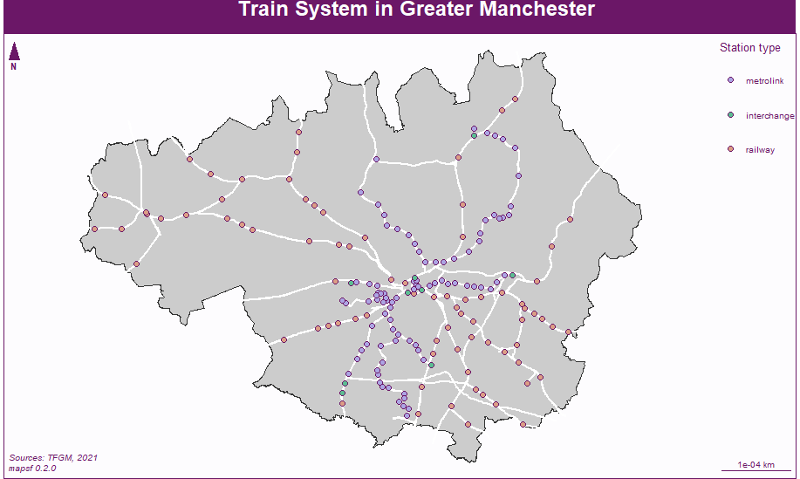
Research area

Slide 3
Model Index List
Index | Indicator | Calculation | Source
Node | N1=Number of stations within 20 min of travel | number of stations reachable within 20 min by metro | TFGM: data.gov.uk (https://data.gov.uk/search?filters%5Bpublisher%5D=Transport+for+Greater+Manchester)
 | N2=Number of d irections served by metro | number of metro services offered at station | TFGM: data.gov.uk (https://data.gov.uk/search?filters%5Bpublisher%5D=Transport+for+Greater+Manchester)
 | N3=Daily frequency of metro services | number of metro departing from station on working day | Timetable on TFGM official website (https://tfgm.com/Pages/default.aspx)
 | N4=Number of directions served by other public transport | number of public transport services offered at station | TFGM: data.gov.uk (https://data.gov.uk/search?filters%5Bpublisher%5D=Transport+for+Greater+Manchester)
 | N5=Number of car parking spaces | distance to next motorway access | TFGM: data.gov.uk (https://data.gov.uk/search?filters%5Bpublisher%5D=Transport+for+Greater+Manchester)
 | N6=Bike Parking Capacity | number of bikes that can be parked at the station | TFGM: data.gov.uk (https://data.gov.uk/search?filters%5Bpublisher%5D=Transport+for+Greater+Manchester)
 | N7=Distance from the closest motorway access | number of car parking spaces at the station | OSM data (https://download.geofabrik.de/europe/great-britain/england/greater-manchester.html)
Place | P1=Number of residents | number of residents within 700 m | Census data 2011 from Nomis (https://www.nomisweb.co.uk/)
 | P2=Number of workers | number of workers within 700 m | Census data 2011 from Nomis (https://www.nomisweb.co.uk/)
 | P3=Land use mix | Degree of functional mix (Vale, 2015) https://www.sciencedirect.com/science/article/pii/S0966692315000733 | OSM data (https://download.geofabrik.de/europe/great-britain/england/greater-manchester.html)
 | P4=Number of POIs | number of points of interest (POIs) within 700 m | OSM data (https://download.geofabrik.de/europe/great-britain/england/greater-manchester.html)
Design | D1=Intersection density | density of intersections per hectare | OSM data (https://download.geofabrik.de/europe/great-britain/england/greater-manchester.html)
 | D2=Accessible network length | length of the accessible network (metres) | OSM data (https://download.geofabrik.de/europe/great-britain/england/greater-manchester.html)
 | D3=Pedshed Ratio | Pedestrian shed ratio (Vale, 2015) | OSM data (https://download.geofabrik.de/europe/great-britain/england/greater-manchester.html)

Slide 4
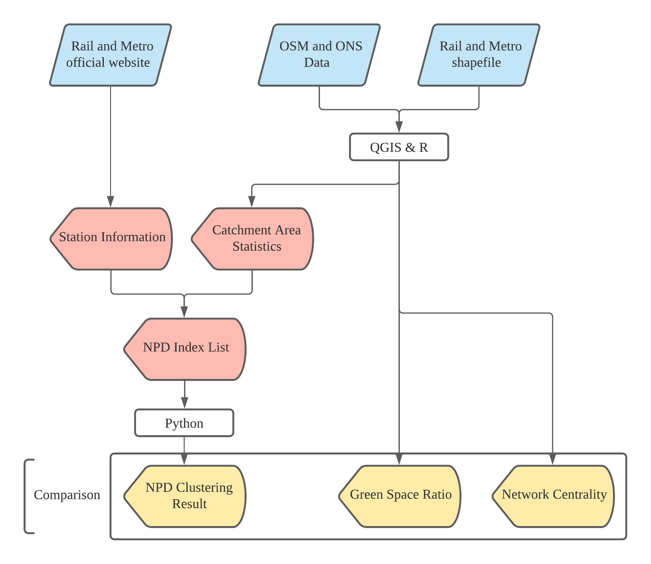
Analysis Process

Slide 5
Centrality Algorithm

Slide 6
Description Table
 | near_station | freq | line | bus_route | bike_capacity | car_park | near_highway | sum_pop | sum_lab | entropy | poi_count | access_lane | intersection | pedstrain
count | 177.000000 | 177.000000 | 177.000000 | 177.000000 | 177.000000 | 177.000000 | 177.000000 | 177.000000 | 177.000000 | 177.000000 | 177.000000 | 177.000000 | 177.000000 | 177.000000
mean | 109.570621 | 43.359463 | 2.169492 | 30.468927 | 97.237288 | 42.259887 | 0.023463 | 5707.118644 | 2603.711864 | 1.219487 | 77.875706 | 3.597380 | 33.282486 | 0.651624
std | 38.833954 | 52.791207 | 0.956186 | 17.451895 | 313.922164 | 112.028153 | 0.015797 | 3298.246291 | 1608.507157 | 2.306460 | 178.525228 | 2.365756 | 53.787771 | 0.119488
min | 13.000000 | 1.875000 | 1.000000 | 1.000000 | 0.000000 | 0.000000 | 0.001885 | 0.000000 | 0.000000 | -6.495189 | 1.000000 | 0.000000 | 0.000000 | 0.149411
25% | 94.000000 | 10.000000 | 2.000000 | 21.000000 | 0.000000 | 0.000000 | 0.012501 | 3364.000000 | 1340.000000 | 0.677120 | 10.000000 | 1.811969 | 4.000000 | 0.591350
50% | 122.000000 | 25.000000 | 2.000000 | 28.000000 | 16.000000 | 0.000000 | 0.019238 | 5754.000000 | 2536.000000 | 1.089299 | 20.000000 | 3.150600 | 13.000000 | 0.668898
75% | 139.000000 | 60.000000 | 2.000000 | 36.000000 | 50.000000 | 32.000000 | 0.030678 | 7483.000000 | 3480.000000 | 1.274947 | 50.000000 | 5.111205 | 38.000000 | 0.731423
max | 152.000000 | 310.000000 | 9.000000 | 110.000000 | 2644.000000 | 1000.000000 | 0.084481 | 17688.000000 | 8561.000000 | 22.401314 | 1107.000000 | 9.914807 | 334.000000 | 0.876976

Slide 7
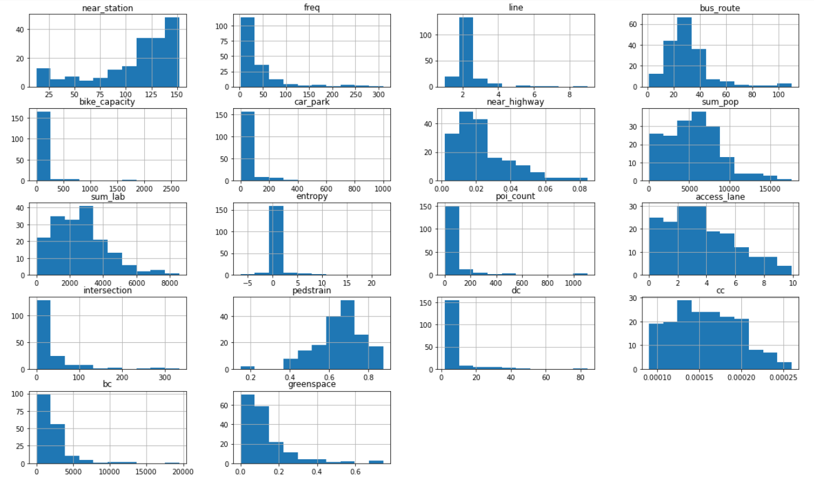
Box plot scatter plot

Slide 8
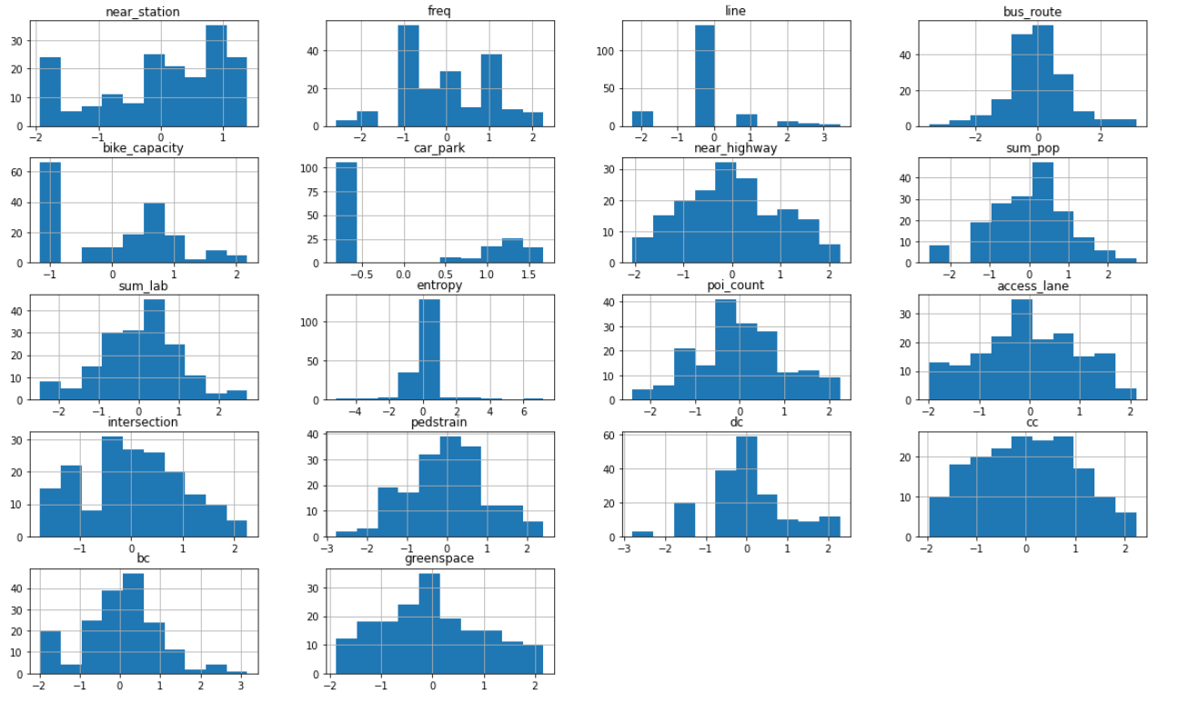
Plot after norm

Slide 9
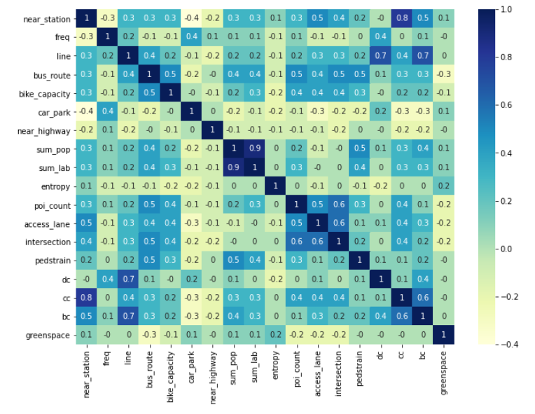
Correlation and co-linearity checks

Slide 10
Factors | Eigenvectors
 | V1 | V2 | V3
near_station | 0.759 | -0.152 | -0.156
freq | -0.325 | 0.789 | -0.072
line | 0.554 | 0.575 | -0.275
bus_route | 0.713 | 0.251 | 0.392
car_park | -0.522 | 0.557 | -0.045
near_highway | -0.340 | 0.022 | 0.807
bike_capacity | 0.610 | 0.282 | 0.358
Eigenvalue (node) | 2.256 | 1.430 | 1.039
Proportion of variance explained (%) | 47.74 | 30.26 | 21.99
sum_pop | 0.959 | -0.047 | -0.235
sum_lab | 0.977 | -0.040 | -0.138
entropy | 0.087 | 0.996 | -0.011
poi_count | 0.393 | -0.006 | 0.920
Eigenvalue (place) | 2.037 | 0.996 | 0.920
Proportion of variance explained (%) | 51.52 | 25.20 | 23.27
access_lane | 0.841 | -0.323 | 0.434
intersection | 0.881 | -0.109 | -0.460
pedstrain | 0.405 | 0.909 | 0.099
Eigenvalue (design) | 1.648 | 0.943 | 0.409
Proportion of variance explained (%) | 54.94 | 31.42 | 13.64

Slide 11
Table of NPD index
 | node | place | design
count | 1.770000e+02 | 1.770000e+02 | 1.770000e+02
mean | -1.694916e-11 | -2.824859e-11 | 2.259885e-11
std | 1.000000e+00 | 1.000000e+00 | 1.000000e+00
min | -2.603170e+00 | -2.632422e+00 | -2.312981e+00
25% | -5.961417e-01 | -6.988066e-01 | -8.028834e-01
50% | 1.274975e-01 | 6.557304e-02 | -4.503739e-02
75% | 6.800634e-01 | 5.938484e-01 | 8.291261e-01
max | 2.664356e+00 | 2.391832e+00 | 2.012096e+00

Slide 12
Cluster Define
 | Number of stations | Example of stations | Avg. node | Avg. place | Avg. design | Avg. n-p-d
C1 | 60 |  | -0.00435 | -0.00273 | -0.00446 | -0.00385
C2 | 46 |  | -0.001 | -0.02111 | 0.008502 | -0.00453
C3 | 39 |  | -0.01682 | 0.002641 | -0.02126 | -0.01181
C4 | 32 |  | 0.004706 | -0.00986 | 0.001135 | -0.00134

Slide 13
Cluster Define
C1
Node: medium; Place: medium; Design: medium-low
C2
Node: medium; Place: low; Design: medium-high
C3
Node: low; Place: low; Design: low
C4
Node: high; Place: high; Design: high

Slide 14
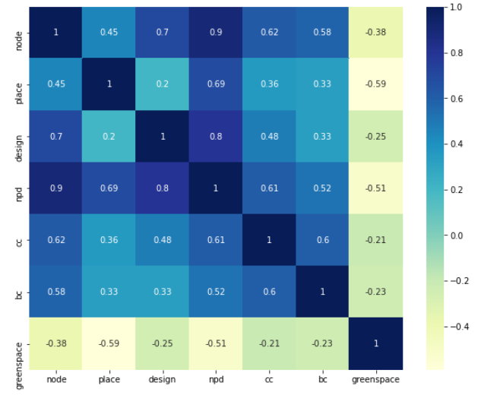
Correlation Matrix of NPD

Slide 15
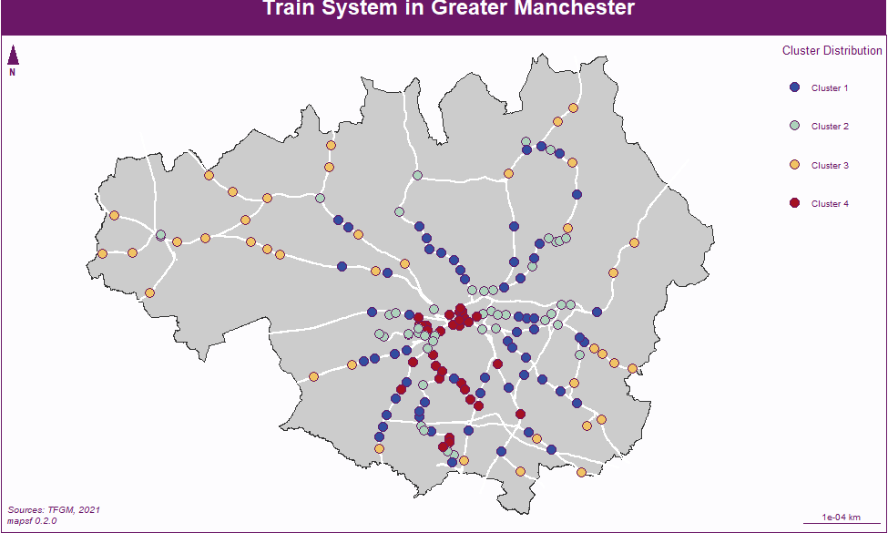
Clustering map visualize & case studies

Slide 16
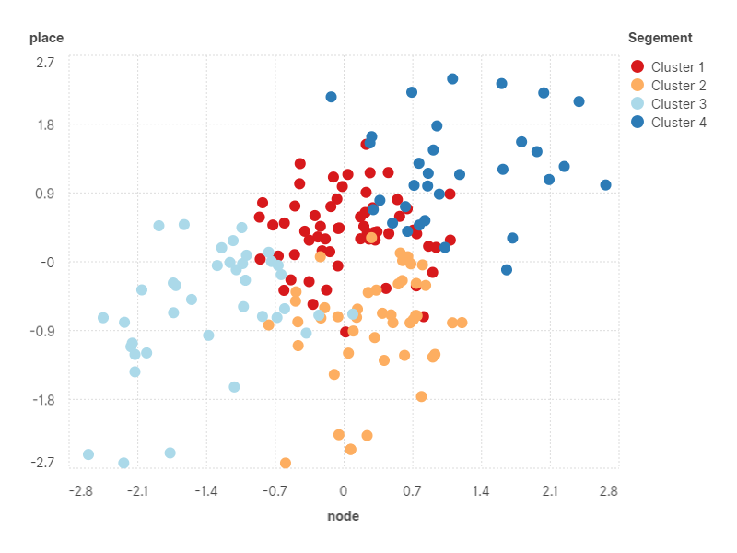
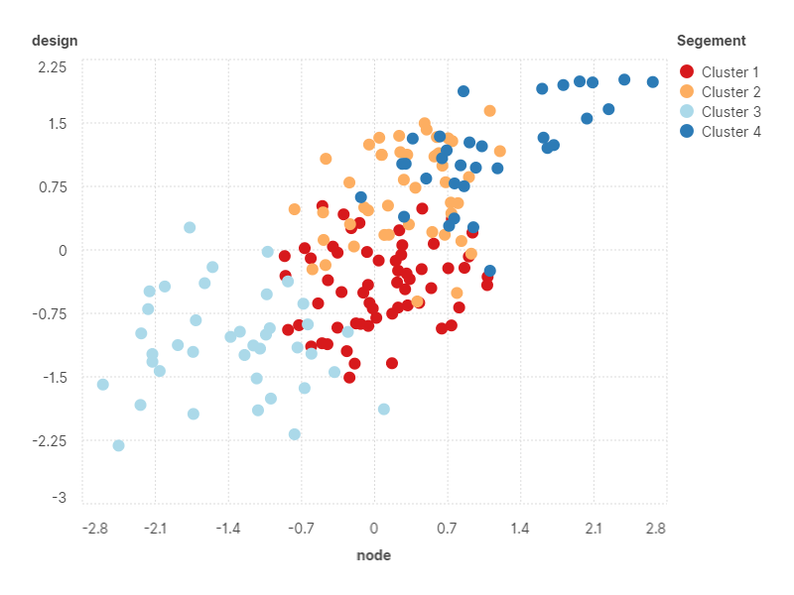
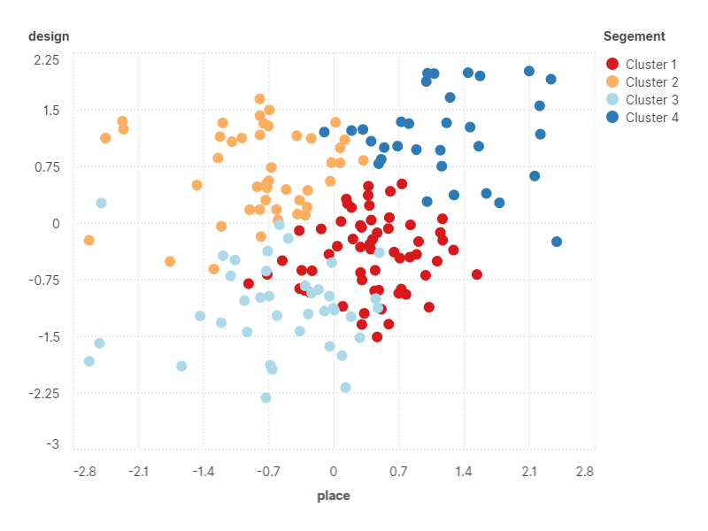
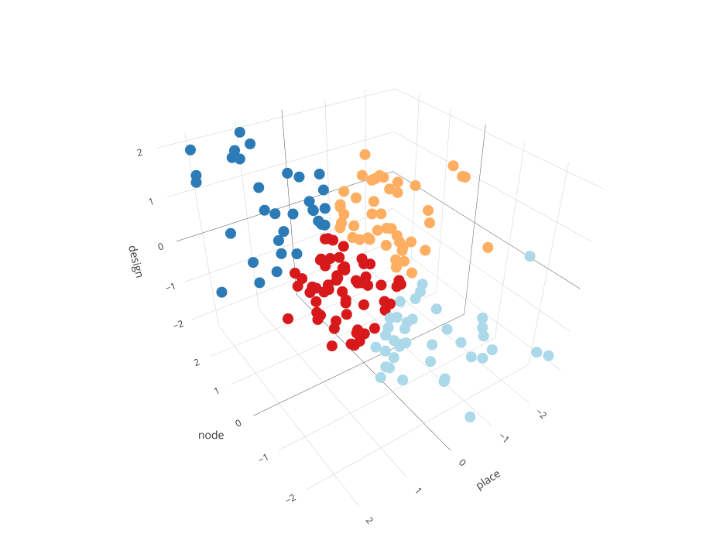

3D Scatter plot 2D
R Square= 0.199
Coefficient= 0.446**
St. Err= 0.068
R Square= 0.489
Coefficient= 0.699**
St. Err= 0.054
a) Scatter Plot of node and place
b) Scatter Plot of node and design
R Square= 0.040
Coefficient= 0.199**
St. Err= 0.074
c) Scatter Plot of place and design
d) Scatter Plot of node, place and design

Slide 17
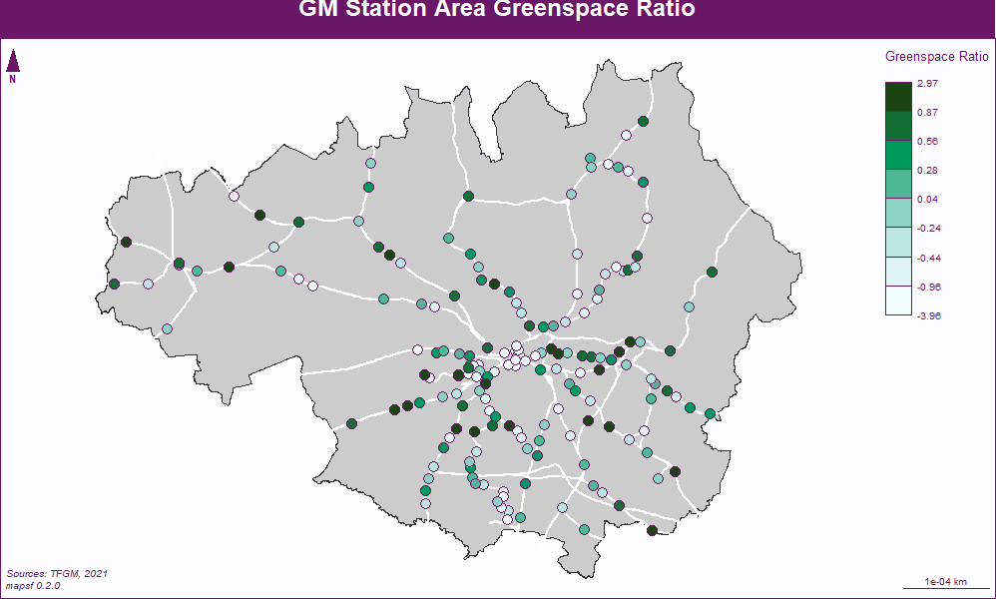
Green space ratio descriptive & map visualize

Slide 18
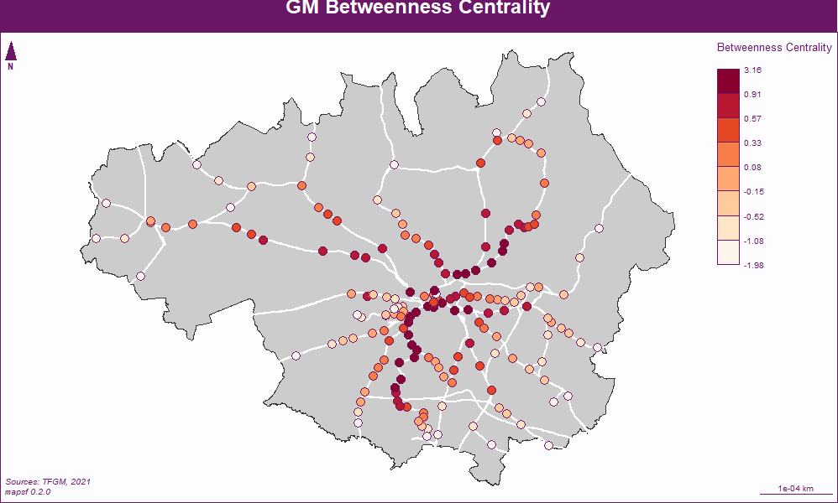
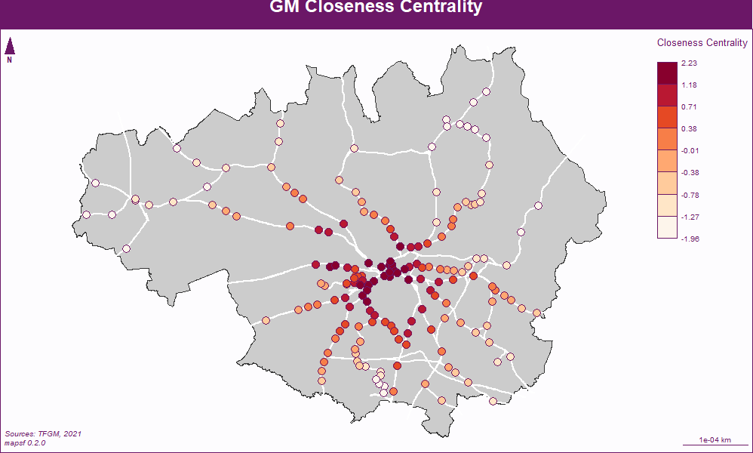
comparison

